Slide 1

Psychopharmacology: Drugs, the Brain, and Behavior
by Meyer, Farrar, Biezonski, Yates

Slide 2
Chapter 2
Structure and Function of the Nervous System
2.1 Cells of the Nervous System
2.2 Electrical Transmission within a Neuron
2.3 Organization of the Nervous System

Slide 3
Chapter 2
Learning Objectives (1 of 3)
2.1.1 Name the different types of cells in the nervous system, including the major types of neurons and glial cells.
2.1.2 List the three major components of a neuron and describe their functions.
2.1.3 Describe the role of myelin in neurotransmission.
2.1.4 Explain how epigenetic modifications can influence gene expression.
2.1.5 Describe how the internal and external structural features of a neuron (e.g., cytoskeleton, membrane) give rise to its functions (e.g., axoplasmic transport, membrane potential).

Slide 4
Chapter 2
Learning Objectives (2 of 3)
2.2.1 Explain the mechanisms that give rise to resting membrane potential.
2.2.2 Describe how local inhibitory and excitatory postsynaptic potentials lead to states of hyperpolarization and depolarization, respectively.
2.2.3 Explain how local potentials from simultaneous inputs are integrated at the axon hillock.
2.2.4 Describe how the integration of sufficient excitatory postsynaptic potentials at the axon hillock can trigger an action potential.
2.2.5 Explain how the distribution of ions between the interior and exterior of the neuron interacts with voltage-gated ion channels to generate action potentials; describe how drugs can influence this process.

Slide 5
Chapter 2
Learning Objectives (3 of 3)
2.3.1 Identify and describe the major divisions of the nervous system.
2.3.2 Describe the structural features of the CNS that provide protection from injury and exchange nutrients and waste products between the brain and its blood supply.
2.3.3 Describe the cellular components that make up the gray and white matter of the spinal cord, and how these components transmit information between the brain and the periphery.
2.3.4 Describe the main biological functions of, and the primary structures within, the following anatomical subdivisions of the CNS: myelencephalon, metencephalon, mesencephalon, diencephalon, telencephalon.
2.3.5 Name the lobes of the cerebral cortex and discuss the functions associated with each.

Slide 6
Cells of the Nervous System (1 of 13)
Embryonic stem cells that form the nervous system become:
  Neurons: transmit information in the form of electrical signaling
  Glial cells: provide metabolic support, protection, and insulation
Sensory neurons: convert physical stimuli into electrical signals
Motor neurons: direct biobehavioral responses appropriate for the situation.
Interneurons: in brain and spinal cord; form interacting neural circuits; responsible for conscious sensations, recognition, memory, decision-making, cognition.
Notes:
Instructor Notes:

Slide 7
Cells of the Nervous System (2 of 13)
BOX 2.1 THE CUTTING EDGE
Embryonic Stem Cells
Undifferentiated cells derived from very early-stage embryos; can proliferate and become specific cell types
Benefits of stem cell research:
  Develop model systems to understand differentiation and aberrations in cancer and other diseases
  Drug development; screening for potential toxic effects
  Develop cell transplantation therapies for degenerative diseases
Adult stem cells may also have promise but are more limited.
Notes:
Instructor Notes:

Slide 8
Cells of the Nervous System (3 of 13)
Neurons Have Three Major External Features
Soma: cell body
Dendrites: receive information from other cells across the synapse between them
Axon: conducts signal (generated at the axon hillock) from cell body to axon terminal
Like other cells, nerve cells have a cell membrane, cytoplasm, nucleus, mitochondria, and are bathed in extracellular fluid.
Notes:
Instructor Notes:

Slide 9
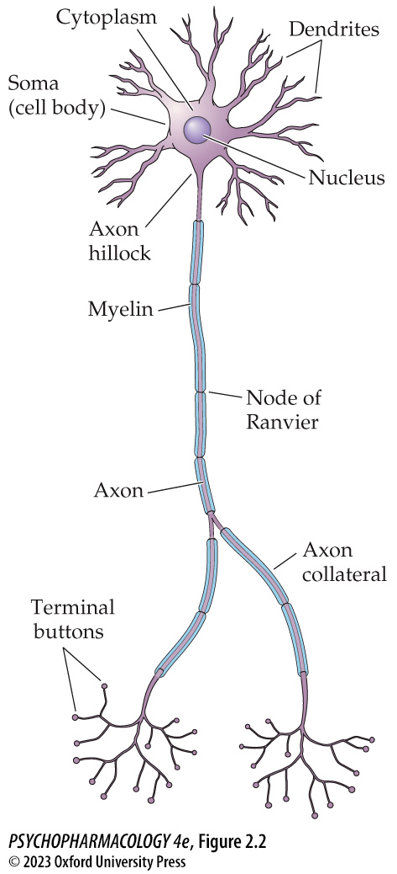
FIGURE 2.2 Principal parts of neurons
Notes:
FIGURE 2.2 Principal parts of neurons
Despite differ­ences in size and shape, most neurons have numerous features in common.

Slide 10
Cells of the Nervous System (4 of 13)
Neurons Have Three Major External Features
Dendrites and soma have thousands of receptors that respond to chemical signals; effect may be excitatory or inhibitory
Convergence: each neuron receives/integrates information from many cells
Divergence: information may be transmitted to a few or thousands of other neurons
Dendritic spines increase the receiving surface area
Notes:
Instructor Notes:

Slide 11
Cells of the Nervous System (5 of 13)
Neurons Have Three Major External Features
Dendrites and spines are constantly modified and can change in size, shape and in response to changes in synaptic transmission.
These changes occur throughout life and are essential for learning.
Patients with mental impairments have fewer or smaller dendritic spines.
Notes:
Instructor Notes:
Animal models of mental impairment: individuals with intellectual disabilities have unusually small, immature dendritic spines; which may result from either a failure of maturation of small spines into larger spines or an inability to maintain spine structure. It is impossible to retain knowledge acquired during development without the large spines.
Individuals with schizophrenia have dendritic spines of a normal size but reduced spine density, particularly in the prefrontal cortex.

Slide 12
Cells of the Nervous System (6 of 13)
Neurons Have Three Major External Features
Axons transmit electrical signals from the axon hillock to the terminals.
Axons may branch to form axon collaterals.
Terminal buttons have synaptic vesicles containing neurotransmitter chemicals.
Most axons are wrapped with myelin sheath, a fatty insulating coating created by layers of glial cells. Nodes of Ranvier are breaks in the myelin sheath, where action potentials are regenerated.
Notes:
Instructor Notes:
The myelin sheath increases speed of conduction along the axon; the thicker the myelin, the faster the conduction.
Two types of glial cells: Schwann cells myelinate peripheral nerves that serve muscles, organs, and glands. Oligodendroglia myelinate nerves in brain and spinal cord.

Slide 13
Cells of the Nervous System (7 of 13)
Neurons Have Three Major External Features
Soma: performs most metabolic functions
Nucleus contains pairs of chromosomes (strands of DNA); a gene is a section of chromosome that codes for a specific protein.
Transcription factors: proteins that promote or obstruct formation of mRNAs by binding to the promoter region of the gene, modifying its rate of transcription
Notes:
Instructor Notes:
Although every cell in the body contains the full genetic library of information, each cell type manufactures only those proteins needed for its specific function.

Slide 14
Cells of the Nervous System (8 of 13)
Neurons Have Three Major External Features
Transcription: production of complementary mRNA from DNA; takes place in nucleus
Translation: building protein molecules by linking amino acids specified by mRNA; takes place on ribosomes in the cytoplasm
Epigenetics: control of gene expression by chromosome modifications that don’t affect the DNA code
Notes:
Instructor Notes:

Slide 15
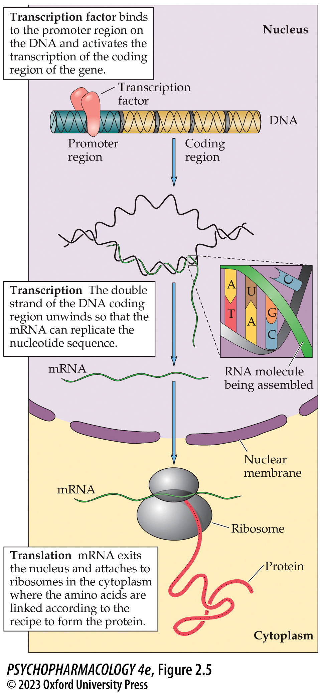
FIGURE 2.5 Stages of protein synthesis
Notes:
FIGURE 2.5 Stages of protein synthesis
Activation of a gene by a transcription factor initiates the formation of mRNA within the nucleus, followed by translation into a protein on the ribosomes in the cytoplasm.

Slide 16
Cells of the Nervous System (9 of 13)
Neurons Have Three Major External Features
Epigenetic modifications:
  DNA Methylation: attachment of methyl groups
  Chromatin remodeling: Chemical modification of histone tails promotes or prevents transcription and changes gene expression.
Epigenetic modification can occur in response to environmental factors.
Epigenetic changes may help explain addictions and aspects of neurological and psychiatric disorders.
Notes:
Instructor Notes:
Chromatin is a complex of small spherical histone proteins around which the DNA wraps

Slide 17
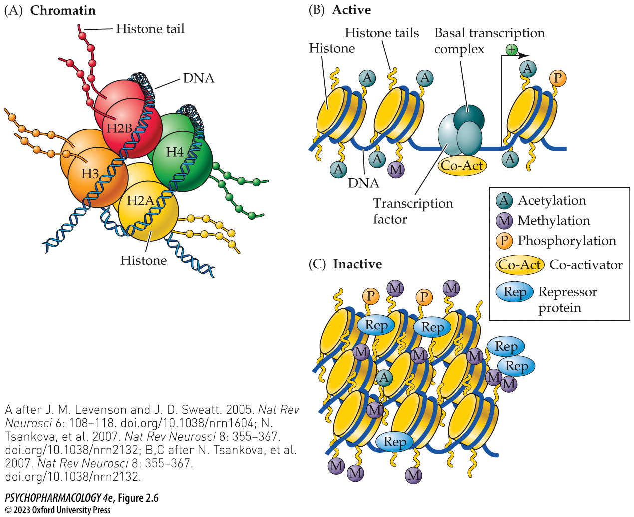
FIGURE 2.6 Epigenetic regulation of gene transcription
Notes:
FIGURE 2.6 Epigenetic regulation of gene transcription
(A) Chromatin is a complex of DNA, histone proteins, and nonhistone proteins (not shown). (B) When histone tails are acetylated, charges open up the chromatin, creating an active state that allows transcription factors to bind to the promoter region of a gene to enhance transcription. (C) The inactive state of chromatin is caused by methylation of histone tails, which pulls the chromatin tighter and prevents the binding of transcription factors, reducing transcription of the gene. (A after J. M. Levenson and J. D. Sweatt. 2005. Nat Rev Neurosci 6: 108–118. doi.org/10.1038/nrn1604; N. Tsankova, et al. 2007. Nat Rev Neurosci 8: 355–367. doi.org/10.1038/nrn2132; B,C after N. Tsankova, et al. 2007. Nat Rev Neurosci 8: 355–367. doi.org/10.1038/nrn2132.)

Slide 18
Cells of the Nervous System (10 of 13)
Neurons Have Three Major External Features
Axoplasmic transport: proteins made in the soma must be transported to the axon terminals
Depends on structures in the cytoskeleton—microtubules and neurofilaments that provide the cell shape
Microtubules form a track for protein transport to the axon terminals, and back.
Notes:
Instructor Notes:
Abnormalities of the cytoskeleton are one of several pathological features of the brain in people with Alzheimer’s disease.

Slide 19
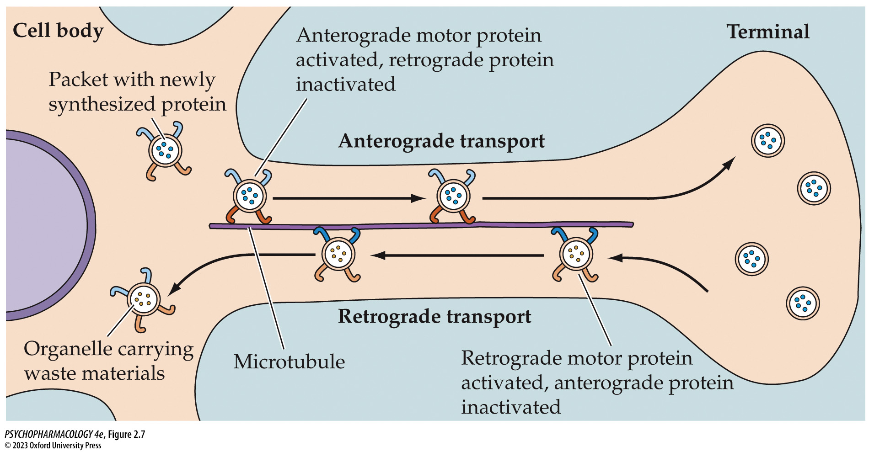
FIGURE 2.7 Axoplasmic transport
Notes:
FIGURE 2.7 Axoplasmic transport
The movement of newly synthesized proteins from the soma to the axon terminals (anterograde) is powered along the microtubules by a motor protein called kinesin. Old proteins are carried from the terminals to the soma (retrograde) by the motor protein dynein.

Slide 20
Cells of the Nervous System (11 of 13)
Characteristics of the Cell Membrane Are Critical for Neuron Function
Proteins in the cell membrane include receptors, enzymes, ion channels, and transporters
Most ion channels are gated channels:
  Ligand-gated channel: opens when a ligand binds to a receptor
  Voltage-gated channel: opens when electrical potential across the membrane is altered
Some ion channels are modified by second messengers
Notes:
Instructor Notes:
Receptors—initial sites of action of neurotransmitters, hormones, and drugs.
Membrane enzymes catalyze biochemical reactions in the cell .
Ion channels and transporters move charged molecules, such as amino acids, glucose, and metabolic products.
Ion channels are specific for only one or two ions. Ions move in the direction of the concentration gradient.

Slide 21
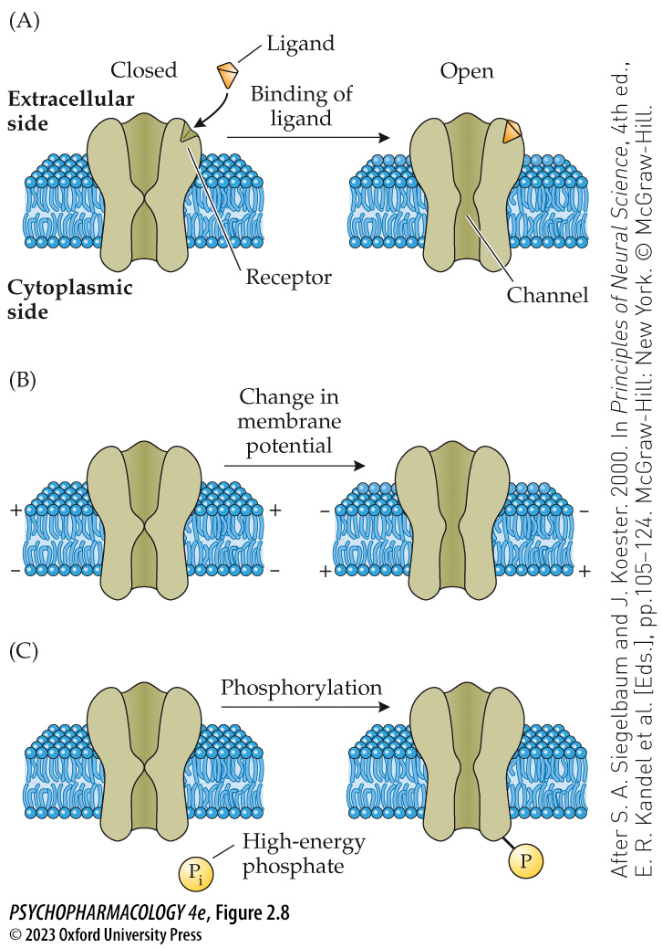
FIGURE 2.8 Ion channels
Notes:
FIGURE 2.8 Ion channels
(A) When a ligand (neurotransmitter, hormone, or drug) binds to a receptor on the channel, the ligand-gated channel protein changes shape and opens the gate, allowing passage of a specific ion. (B) A voltage-­gated channel is opened when the electrical potential across the membrane near the channel is altered. (C) Modification of a channel by a second messenger, which produces intracellular phosphorylation (addition of a phosphate group) and regulates the state of the channel. (After S. A. Siegelbaum and J. Koester. 2000. In Principles of Neural Science, 4th ed., E. R. Kandel et al. [Eds.], pp.105–124. McGraw-Hill: New York. © McGraw-Hill.)

Slide 22
Cells of the Nervous System (12 of 13)
Glial Cells Provide Vital Support for Neurons
Schwann cells: form myelin sheaths in the PNS, wrap one axon, promote regeneration of damaged axons
Oligodendroglia: form myelin sheaths in the CNS; wrap many axons
Astrocytes: structural support for neurons; modulate the extracellular environment; take up excess neurotransmitters
Microglia remove dying cells by phagocytosis at sites of nerve damage; source of immune response in the CNS
Notes:
Instructor Notes:

Slide 23
Cells of the Nervous System (13 of 13)
CLICKER QUESTION 1
What is the correct sequence in describing neuronal transmission?
Dendrites → axon → axon hillock → terminals → soma
Axon → axon hillock → soma → dendrites → terminals
Dendrites → soma → axon hillock → axon → terminals
Notes:
Instructor Notes:
Correct answer: c

Slide 24
Review of Learning Objectives (1 of 3)
2.1.1 Name the different types of cells in the nervous system, including the major types of neurons and glial cells.
2.1.2 List the three major components of a neuron and describe their functions.
2.1.3 Describe the role of myelin in neurotransmission.
2.1.4 Explain how epigenetic modifications can influence gene expression.
2.1.5 Describe how the internal and external structural features of a neuron (e.g., cytoskeleton, membrane) give rise to its functions (e.g., axoplasmic transport, membrane potential).

Slide 25
Electrical Transmission within a Neuron (1 of 7)
Ion Distribution Is Responsible for the Cell’s Resting Potential
Resting membrane potential: inside of cell is more negative than outside: –70 millivolts (mV); it is polarized.
Na⁺ and Cl⁻ are more concentrated outside the cell; some K⁺ channels are not gated; concentration of K⁺ forces it outward while electrostatic pressure pulls it in
The Na⁺–K⁺ pump helps maintain the ion distribution.
Action potential: rapid change in membrane potential that is propagated down the length of the axon
Notes:
Instructor Notes:
Selective permeability of the membrane and uneven distribution of ions inside and outside the cell are responsible for the membrane potential.
When the two forces on K+ (inward electrostatic pressure and outward concentration gradient) are balanced at the equilibrium potential for potassium, the membrane potential is still more negative inside (−70 mV).
It requires energy (ATP) to move ions against their concentration gradients.

Slide 26
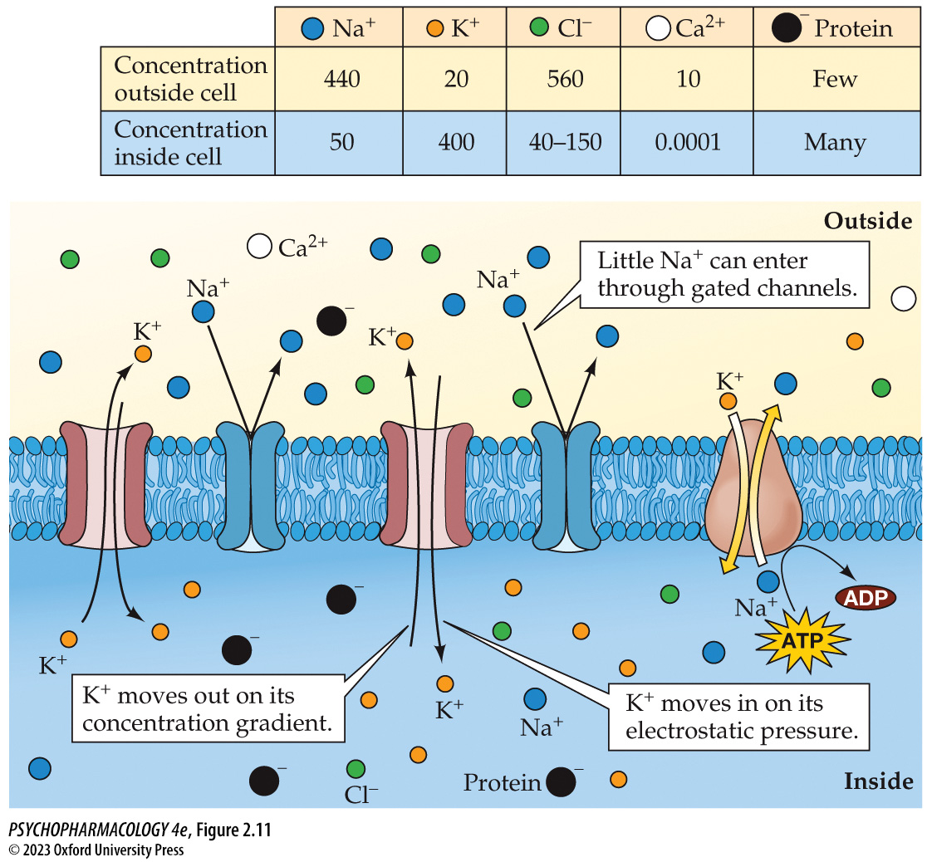
FIGURE 2.11 Distribution of ions inside and outside a neuron at resting potential (1)
Notes:
FIGURE 2.11 Distribution of ions inside and outside a neuron at resting potential
Na⁺ and Cl⁻ are more concentrated outside the cell and cannot move in freely through their gated channels. Some K⁺ channels are not gated, allowing the concentration of the ion to force K⁺ outward while electrostatically it is pulled in. At −70 mV, equilibrium between the two forces is reached. The Na⁺–K⁺ pump helps to maintain the ion distribution. It requires significant energy (ATP) to move ions against their concentration gradients.

Slide 27
Electrical Transmission within a Neuron (2 of 7)
Local Potentials Are Small, Transient Changes in Membrane Potential
Depolarization: a stimulus opens Na⁺ channels to allow a few ions into cell; inside of cell becomes slightly more positive (excitatory)
Hyperpolarization: a stimulus opens Cl– channels to allow a few ions into cell; inside of cell becomes more negative (inhibitory)
Neurotransmitters act on the postsynaptic membranes; effects are called excitatory postsynaptic potentials (EPSPs) or inhibitory postsynaptic potentials (IPSPs).
Notes:
Instructor Notes:

Slide 28
Electrical Transmission within a Neuron (3 of 7)
Local Potentials Are Small, Transient Changes in Membrane Potential
Graded – the larger the stimulus, the greater the magnitude of hyperpolarization or depolarization.
Decay rapidly
Summation (integration): several small depolarizations or hyperpolarizations can add up to larger changes in membrane potential
Integration of EPSPs and IPSPs occurs in the axon hillock
Notes:
Instructor Notes:

Slide 29
Electrical Transmission within a Neuron (4 of 7)
Sufficient Depolarization at the Axon Hillock Opens Voltage-Gated Na⁺ Channels, Producing an Action Potential
When summation of local potentials reaches the threshold of -50 mV, many voltage-gated Na⁺ channels open, Na+ rushes into the cell, and membrane potential jumps to +40 mV.
Action potential lasts about 1 millisecond.
Na⁺ channels close and cannot be opened for a fixed period—the absolute refractory period.
Notes:
Instructor Notes:

Slide 30
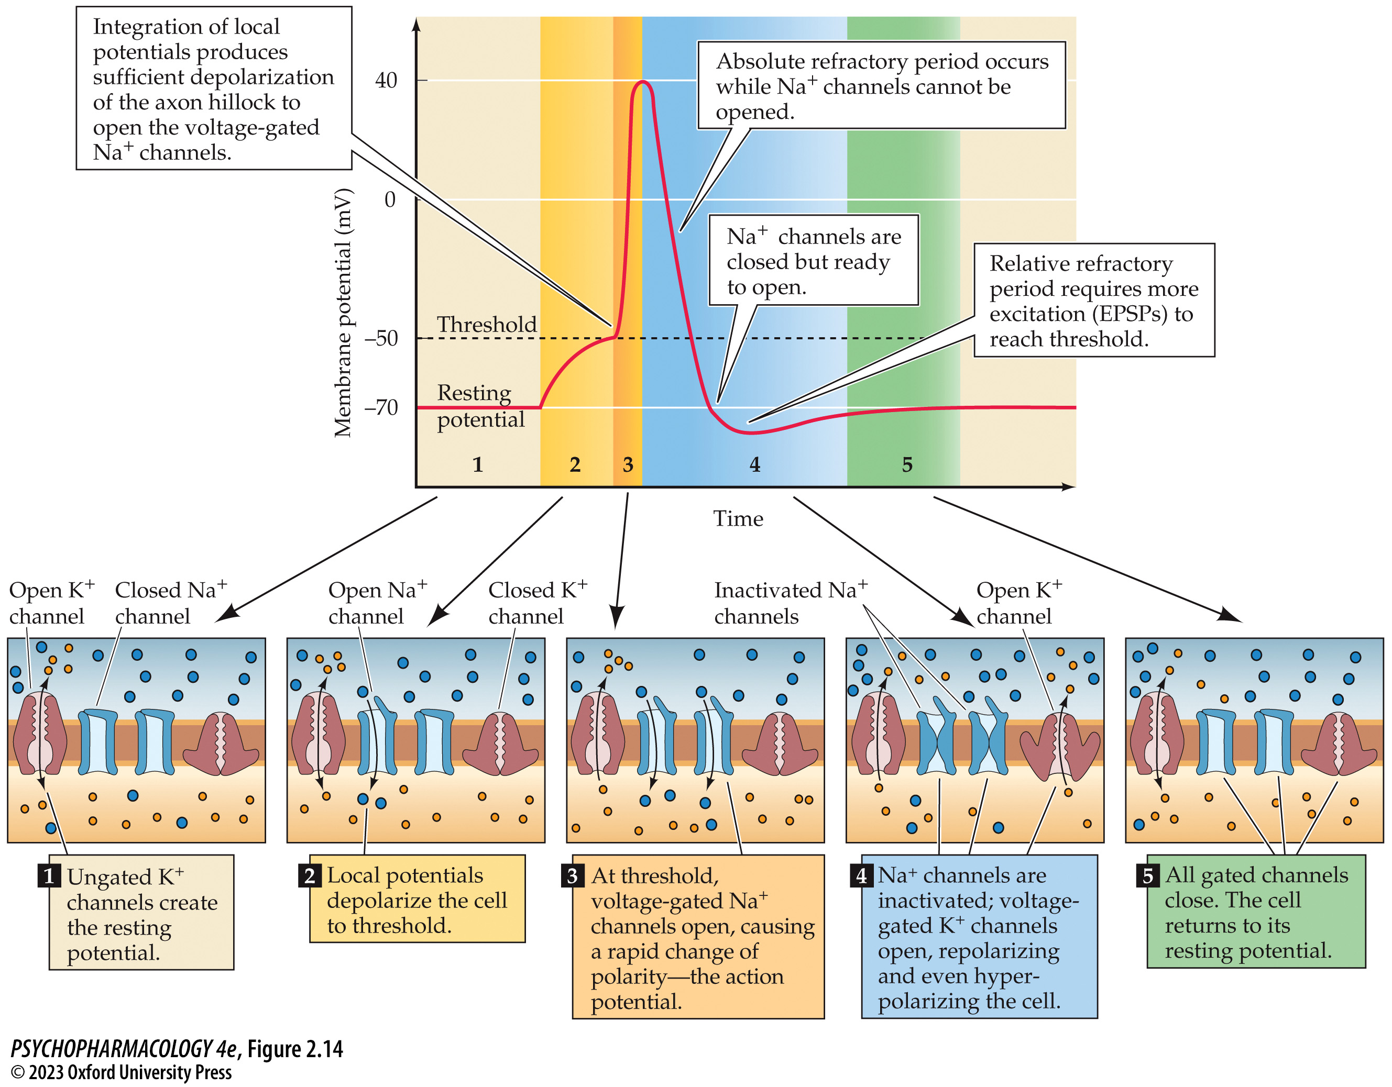
FIGURE 2.14 Stages of the action potential (1)
Notes:
FIGURE 2.14 Stages of the action potential
Opening and closing of Na⁺ and K⁺ channels are responsible for the characteristic shape of the action potential.

Slide 31
Electrical Transmission within a Neuron (5 of 7)
Sufficient Depolarization at the Axon Hillock Opens Voltage-Gated Na⁺ Channels, Producing an Action Potential
Rising membrane potential opens voltage-gated K⁺ channels; K⁺ moves out and membrane returns to resting potential.
Membrane is briefly hyperpolarized—the relative refractory period
Saltatory conduction: in myelinated axons, regeneration of the action potential occurs only at nodes of Ranvier; faster transmission; uses less energy for Na⁺–K⁺ pumps
Notes:
Instructor Notes:
Action potentials are “all or none”—size is unrelated to amount of stimulation.
Action potential moves along axon because Na⁺ ions spread passively to nearby regions, which changes the membrane potential to threshold, opening more Na⁺ channels.

Slide 32
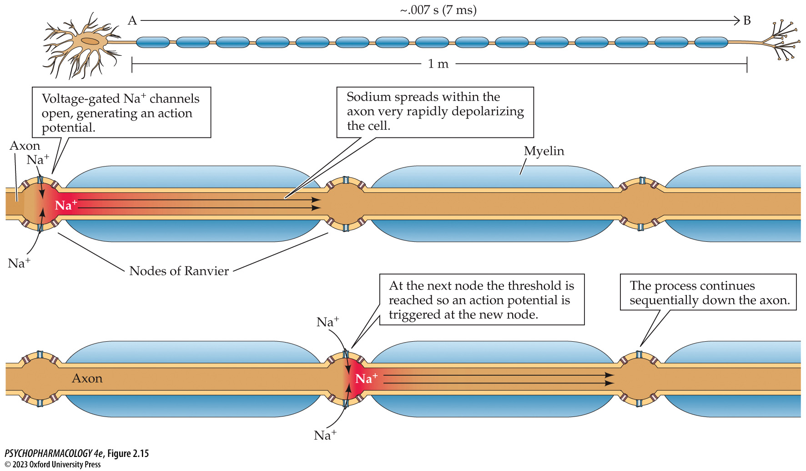
FIGURE 2.15 Conduction along myelinated axons (1)
Notes:
FIGURE 2.15 Conduction along myelinated axons
The generation of the action potential at one node spreads depolarization along the axon, which in turn changes the membrane potential to threshold and opens voltage-gated Na+ channels at the next node of Ranvier.

Slide 33
Electrical Transmission within a Neuron (6 of 7)
Drugs and Poisons Alter Axon Conduction
Drugs used for local anesthesia (e.g., Novocaine) block voltage-gated Na⁺ channels
Some antiepileptic drugs bind to closed Na⁺ channels, prolonging the refractory state of the channel, slowing down the firing rate.
Neurotoxins such as saxitoxin in shellfish exposed to red tides block Na+ channels throughout the nervous system, because the neurotoxin is ingested.
Notes:
Instructor Notes:

Slide 34
Electrical Transmission within a Neuron (7 of 7)
CLICKER QUESTION 2
In an experiment, a neuron is stimulated with electrical charges of increasing strength. With each stimulation, an action potential is generated, and the membrane potential reaches 40 mV. Which of the following statements does this illustrate?
Anything above threshold produces an all-or-none response.
The threshold potential is 40 mV.
Depolarization is dependent on the strength of the stimulus.
Notes:
Instructor Notes:
Correct answer: a

Slide 35
Review of Learning Objectives (2 of 3)
2.2.1 Explain the mechanisms that give rise to resting membrane potential.
2.2.2 Describe how local inhibitory and excitatory postsynaptic potentials lead to states of hyperpolarization and depolarization, respectively.
2.2.3 Explain how local potentials from simultaneous inputs are integrated at the axon hillock.
2.2.4 Describe how the integration of sufficient excitatory postsynaptic potentials at the axon hillock can trigger an action potential.
2.2.5 Explain how the distribution of ions between the interior and exterior of the neuron interacts with voltage-gated ion channels to generate action potentials; describe how drugs can influence this process.

Slide 36
Organization of the Nervous System (1 of 18)
The Nervous System Comprises the Central and Peripheral Divisions
Central nervous system (CNS): brain and spinal cord
Peripheral nervous system (PNS): all nerves outside CNS
  Somatic system controls voluntary muscles with spinal nerves and cranial nerves.
  Autonomic nervous system controls function of organs and glands with autonomic nerves and some cranial nerves.
Notes:
Instructor Notes:

Slide 37
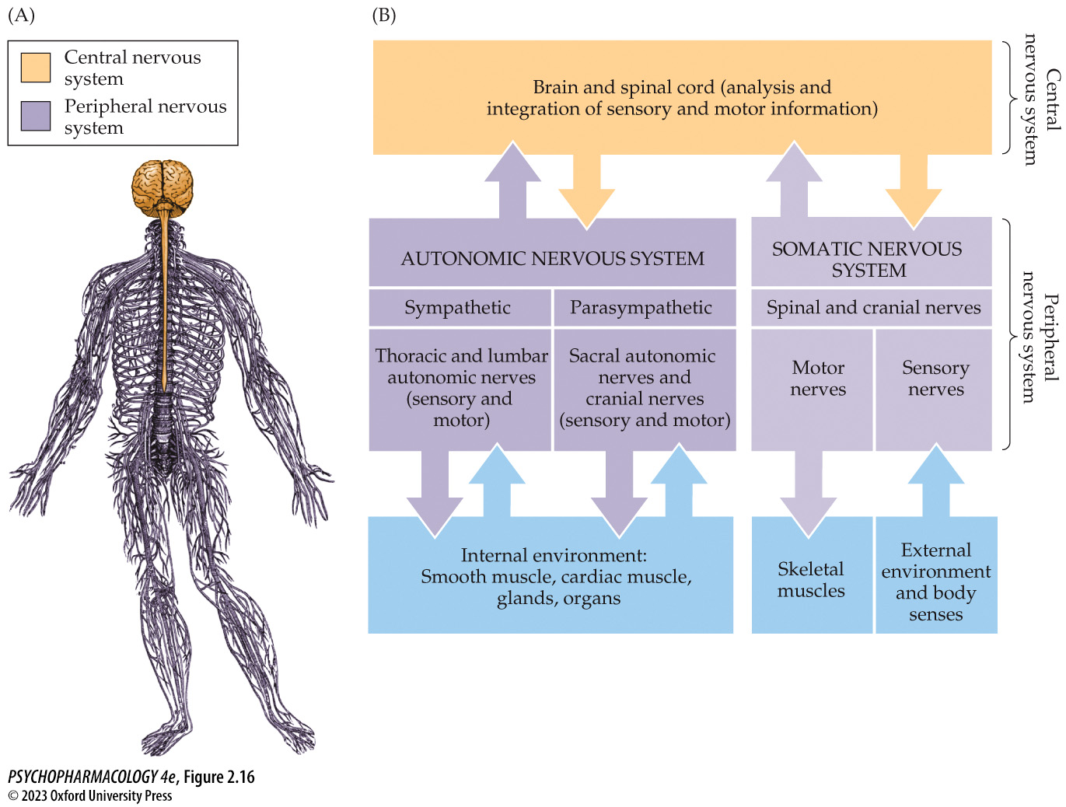
FIGURE 2.16 The central and peripheral nervous systems
Notes:
FIGURE 2.16 The central and peripheral nervous systems
(A) The brain and spinal cord, shown in yellow, make up the central nervous system (CNS). The peripheral nervous system (PNS), shown in purple, connects all parts of the body to the CNS. (B) Organization of the nervous system: internal and external environments send sensory information by way of peripheral nerves to the CNS, where neural circuits analyze and integrate the information before sending signals to regulate muscle and internal organ function.

Slide 38
Organization of the Nervous System (2 of 18)
The Nervous System Comprises the Central and Peripheral Divisions
Spinal nerves are mixed nerves:
  Sensory afferent nerves carry information to the spinal cord; soma are in the dorsal root ganglia.
  Motor efferent nerves result in voluntary movement; soma are in ventral horn.
Cranial nerves serve head and neck; not all are mixed nerves; some innervate glands and organs
Notes:
Instructor Notes:
The vagus nerve (cranial nerve X) is unique among the cranial nerves because it communicates with numerous organs in the viscera, including heart, lungs, and gastrointestinal tract. The vagus
consists of both sensory and motor neurons.

Slide 39
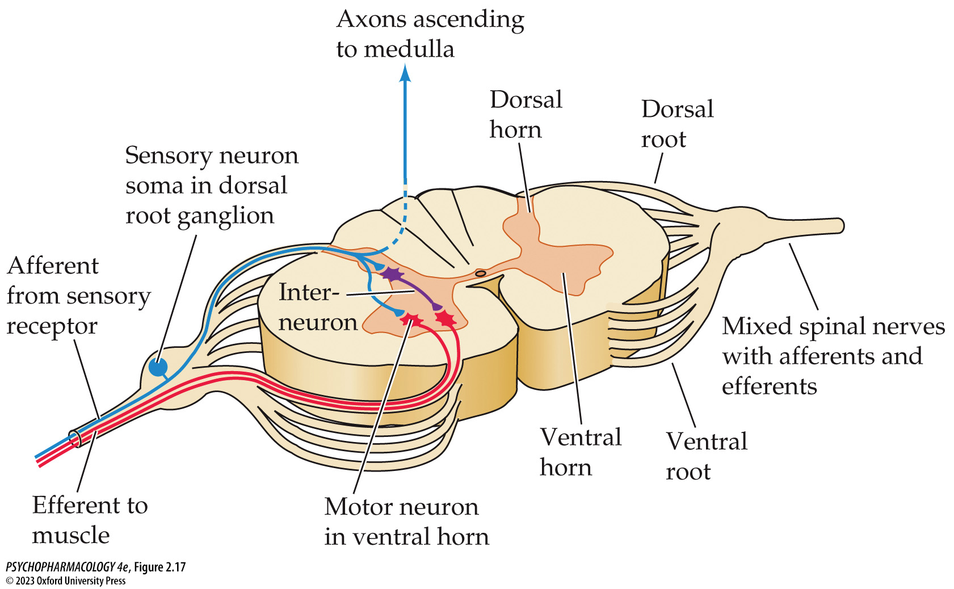
FIGURE 2.17 Spinal nerves of the peripheral nervous system (PNS)
Notes:
FIGURE 2.17 Spinal nerves of the peripheral nervous system (PNS)
Cross-section of the spinal cord shows mixed spinal nerves with sensory afferents entering the dorsal horn and motor efferents leaving the ventral horn to innervate skeletal muscles. Note that the soma for the afferent neuron is in the dorsal root ganglion.

Slide 40
Organization of the Nervous System (3 of 18)
The Nervous System Comprises the Central and Peripheral Divisions
Autonomic nerves innervate smooth muscles; control digestion, blood pressure, body temperature, and other functions.
Sympathetic division dominates during times of stress, excitement, and exertion; the “fight-or-flight” system.
Parasympathetic division dominates when energy reserves can be conserved and stored for later use.
Notes:
Instructor Notes:
Sympathetic division increases heart rate and blood pressure, stimulates secretion of adrenaline, and increases blood flow to skeletal muscles.
Parasympathetic division increases salivation, digestion, and storage of glucose and other nutrients, slows heart rate and decreases respiration.

Slide 41
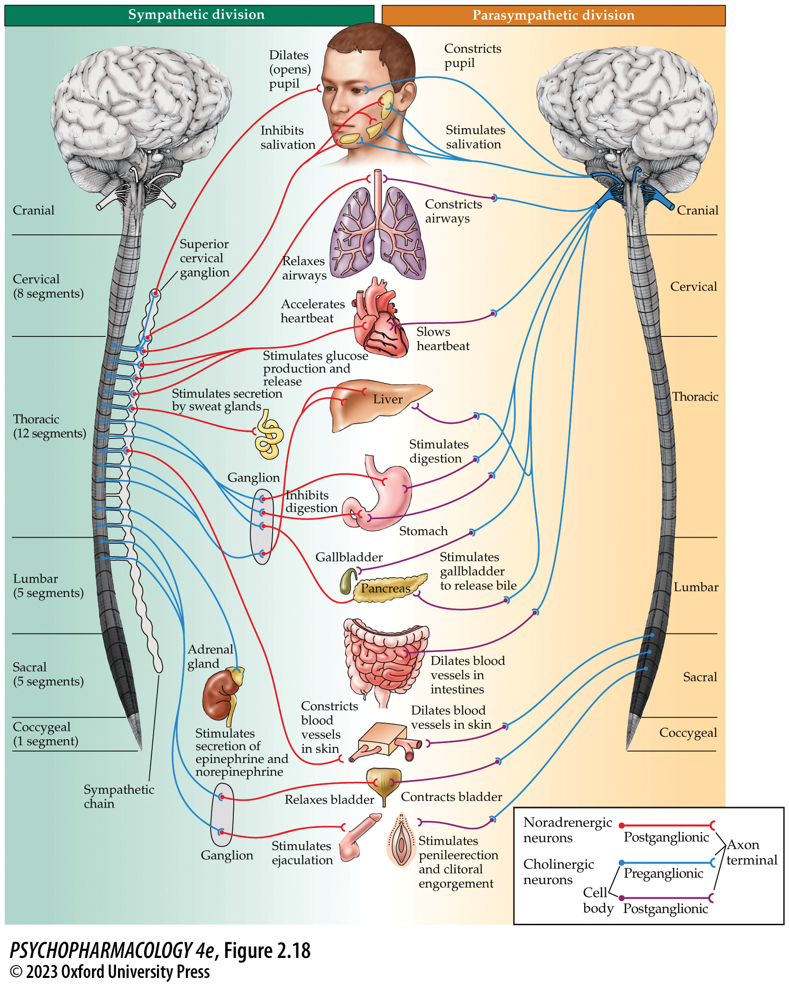
FIGURE 2.18 Autonomic nervous system (ANS)
Notes:
FIGURE 2.18 Autonomic nervous system (ANS)
The internal organs, smooth muscles, and glands served by the ANS have both sympathetic and parasympathetic regulation. The two divisions have opposing effects on the organs; the sympathetic effects prepare the individual for action, and the parasympathetic effects serve to generate and store energy and reduce energy expenditure. Acetylcholine is the neuro­trans­mitter released in all autonomic ganglia because preganglionic fibers are cholinergic neurons. At the target organs, the parasympathetic neurons release acetylcholine once again, while sympathetic neurons (noradrenergic neurons) release norepinephrine. Their anatomical and neuro­transmitter differences are described in the text and are summarized in Table 2.3.

Slide 42
Organization of the Nervous System (4 of 18)
The Nervous System Comprises the Central and Peripheral Divisions
Sympathetic nerves originate in the thoracic and lumbar spinal cord; release acetycholine in ganglia; release norepinephrine at the target organ; ganglia are next to spinal cord
Parasympathetic nerves originate in the brain and sacral spinal cord; release acetylcholine; ganglia are near target organs
Notes:
Instructor Notes:
Many psychotherapeutic drugs alter norepinephrine or acetylcholine in the brain to relieve symptoms. Altering these neurotransmitters in the peripheral nerves can produce side effects, such as elevated blood pressure, dry mouth, and urinary problems.

Slide 43
Organization of the Nervous System (5 of 18)
CNS Functioning Is Dependent on Structural Features
Meninges: layers of tissue that cover and protect brain and spinal cord
  Dura mater: outermost layer; toughest
  Arachnoid: has a weblike sublayer (subarachnoid space) filled with cerebrospinal fluid (CSF)
  Pia mater: thin layer on top of nerve tissue
CSF surrounds brain and spinal cord, fills cerebral ventricles and central channel in the spinal cord; formed in the choroid plexus
Notes:
Instructor Notes:
Capillaries in the choroid plexus don’t have tight junctions (no blood–brain barrier). CSF helps in the exchange of nutrients and waste products between the brain and the blood.

Slide 44
Organization of the Nervous System (6 of 18)
The CNS Has Six Distinct Regions Reflecting Embryological Development
CNS begins as the neural tube; develops into forebrain, midbrain, hindbrain, and spinal cord
Organization is hierarchical; levels have overlapping functions; higher levels partially replicate functions of lower ones but provide increased behavioral complexity and refined control.
Each region is divided into clusters of cell bodies (nuclei), and their associated bundles of axons (tracts).
Notes:
Instructor Notes:
In the PNS, clusters of cell bodies are called ganglia and bundles of axons are called nerves.

Slide 45
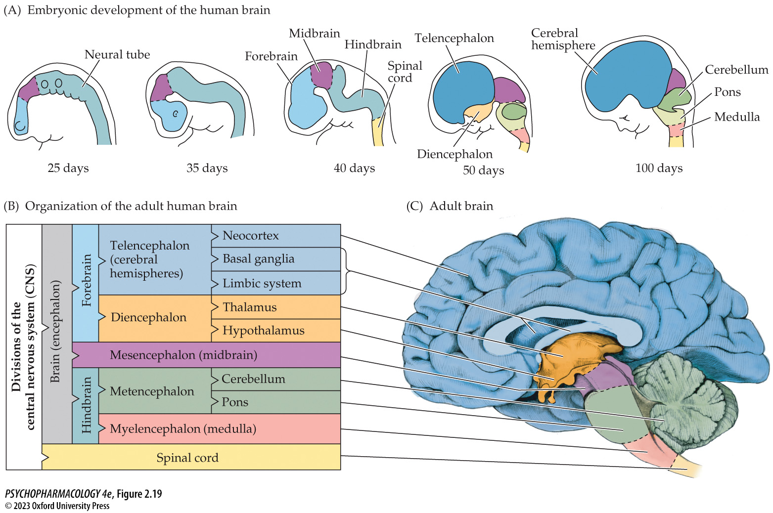
FIGURE 2.19 Divisions of the central nervous system (CNS)
Notes:
FIGURE 2.19 Divisions of the central nervous system (CNS)
(A) Beginning with the primitive neural tube in the human embryo, the CNS develops rapidly. By day 50 of gestation, the six divisions of the adult CNS are apparent in the fetus. (B) The organization of the CNS (brain and spinal cord) presented in the table is color-coded to match the divisions shown in the adult brain (sagittal section) (C).

Slide 46
Organization of the Nervous System (7 of 18)
The CNS Has Six Distinct Regions Reflecting Embryological Development
Neurotrophic factors: proteins that influence growth, cell differentiation and survival, and synaptic connections
NGF (nerve growth factor): secreted by peripheral organs; guides growth of axons to establish synapses at target organs
BDNF (brain-derived neurotrophic factor): from skeletal muscle; guides motor neuron development and survival.
Schwann cells release growth factor to regenerate damaged axons.
Neurotrophic factors are potential therapeutic agents for neuro-degenerative diseases and psychiatric disorders.
Notes:
Instructor Notes:

Slide 47
Organization of the Nervous System (8 of 18)
The CNS Has Six Distinct Regions Reflecting Embryological Development
Spinal cord: gray matter contains neuron cell bodies; white matter is myelinated axons; enlarges into the brain stem—medulla, pons, and midbrain
  Many cranial nerves originate in the brain stem.
Medulla (myelencephalon): regulates heart rate, digestion, respiration, blood pressure, coughing, vomiting
Notes:
Instructor Notes:
Much of the brainstem volume is made up of ascending and descending axons between spinal cord and higher brain regions.
Area postrema in the medulla the vomiting center, has a reduced blood–brain barrier; initiates vomiting in response to toxins.

Slide 48
Organization of the Nervous System (9 of 18)
The CNS Has Six Distinct Regions Reflecting Embryological Development
Metencephalon: pons and cerebellum
Pons:
  Reticular formation: collection of nuclei that influence arousal, attention, sleep, and muscle tone
  Locus coeruleus: axons extend to many forebrain areas; neurons use norepinephrine; cause arousal, increased vigilance, and attention
  Dorsal and median raphe nuclei: neurons use serotonin; axons reach all forebrain areas; regulate sleep, aggression, impulsiveness, emotion, etc.
Notes:
Instructor Notes:

Slide 49
Organization of the Nervous System (10 of 18)
The CNS Has Six Distinct Regions Reflecting Embryological Development
Cerebellum: sensorimotor center
Connects to pons by axon bundles called cerebellar peduncles
Receives visual, auditory, and somatosensory input, and information about body position and balance from the vestibular system
Coordinates sensory information with motor information from the cerebral cortex
Notes:
Instructor Notes:

Slide 50
Organization of the Nervous System (11 of 18)
The CNS Has Six Distinct Regions Reflecting Embryological Development
Mesencephalon (midbrain) has two divisions: tectum contains parts of the visual and auditory systems
Tegmentum:
  Periaqueductal gray (PAG): modulation of pain; rich in opioid receptors; important site for morphine binding.
  Substantia nigra: long axons innervate the striatum in the basal ganglia; use dopamine; critical for initiation and modulation of movement.
  Ventral tegmental area (VTA): use dopamine; some axons extend into limbic system—the mesolimbic tract.
Notes:
Instructor Notes:
Cell death in the substantia nigra is the cause of Parkinson’s disease.

Slide 51
Organization of the Nervous System (12 of 18)
The CNS Has Six Distinct Regions Reflecting Embryological Development
Diencephalon: thalamus and hypothalamus
Thalamus receives sensory and motor information and passes it on to the cortex.
Hypothalamus receives information about the internal environment and coordinates with the limbic system to maintain internal states (homeostasis).
Notes:
Instructor Notes:
The thalamus allows cortex to focus on selective sensory signals, and diminishes significance of others.
Hypothalamus regulates body temperature, salt−water balance, hunger, thirst, energy metabolism, reproductive behaviors, and emotional responses.

Slide 52
Organization of the Nervous System (13 of 18)
BOX 2.5 OF SPECIAL INTEREST
Neuroendocrine Response to Stress
HPA axis: stress response depends on interaction of the hypothalamus, pituitary gland, and adrenal gland
Paraventricular nucleus in the hypothalamus secretes corticotropin-releasing factor (CRF), anterior pituitary secretes adrenocorticotropic hormone (ACTH); adrenal cortex increases secretion of cortisol
Overuse of the stress response leads to damaging changes to brain and body.
Notes:
Instructor Notes:

Slide 53
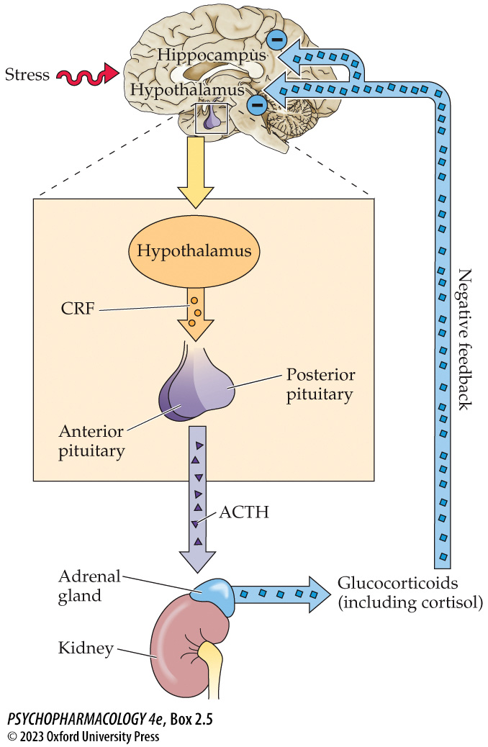
Box 2.5 Of Special Interest: Neuroendocrine Response to Stress
Notes:
Box 2.5 Of Special Interest: Neuroendocrine Response to Stress

Slide 54
Organization of the Nervous System (14 of 18)
The CNS Has Six Distinct Regions Reflecting Embryological Development
Telencephalon: cerebral cortex, limbic system, basal ganglia.
Limbic system integrates emotional responses and regulates motivated behavior and learning.
  Hippocampus: closely associated with establishment of new long-term memories and spatial memory
  Amygdala: coordinates various components of emotional responses through profuse connections with other brain areas
Basal ganglia are involved in motor control.
Notes:
Instructor Notes:

Slide 55
Organization of the Nervous System (15 of 18)
The Cerebral Cortex Is Divided into Four Lobes, Each Having Primary, Secondary, and Tertiary Areas
Cerebral cortex: convoluted, with deep grooves (fissures), smaller grooves (sulci), and bulges (gyri).
Corpus callosum: neural pathway that connects the hemispheres.
Each hemisphere has four lobes (parietal, occipital, temporal, frontal) Each lobe has:
  Primary cortex: conscious awareness of sensory experience and initial processing
  Secondary cortex: analyzes information from primary areas, providing perception of the stimulus. Also where memories are stored.
  Tertiary association areas: higher-order perceptual functions needed for purposeful action
Notes:
Instructor Notes:
Convolutions increase the surface area. Cells are arranged in six layers, appearing gray because of high concentration of cell bodies.
Except for olfaction, all sensory information arrives in the appropriate primary cortex via projection neurons from the thalamus.
Sensory information from the left side of the body goes to the right cerebral hemisphere first, and information from the right side goes to the left hemisphere, but for visual information: left half of visual field of each eye goes to the right occipital lobe and right half of visual field of each eye goes to the left occipital lobe.

Slide 56
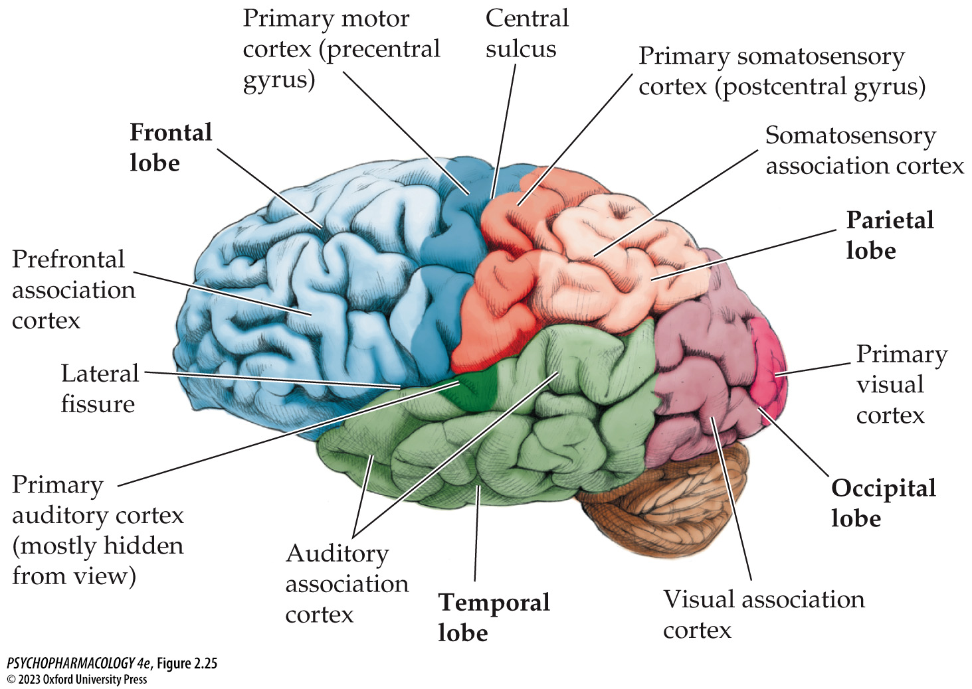
FIGURE 2.25 Lateral view of the exterior cerebral cortex
Notes:
FIGURE 2.25 Lateral view of the exterior cerebral cortex
The four lobes of the cerebral cortex are shown with distinct colors. Within each lobe is a primary area (darker in color) and secondary and tertiary association cortices. The caudal-most three lobes carry out sensory functions: vision (occipital), auditory (temporal), and somatosensory (parietal). The frontal lobe serves as the executive mechanism that plans and organizes behavior and initiates the appropriate sequence of actions.

Slide 57
Organization of the Nervous System (16 of 18)
The Cerebral Cortex Is Divided into Four Lobes, Each Having Primary, Secondary, and Tertiary Areas
Frontal lobe: primary motor cortex mediates voluntary muscle movements; secondary motor cortex stores memories for well-learned motor sequences
Prefrontal cortex: critical for making decisions, planning actions, and evaluating optional strategies. This area is impaired in many psychiatric disorders.
Notes:
Instructor Notes:
Motor neurons beginning in the frontal cortex are crossed: areas of the right primary motor cortex control movements of limbs on the left side of the body, and vice versa.

Slide 58
Organization of the Nervous System (17 of 18)
Rat and Human Brains Have Many Similarities and Some Differences
All mammalian brains have the same major subdivisions, organized similarly.
Relative size of the brain regions differs.
  Rats have larger olfactory bulbs - sense of smell is more important
  Cerebral hemispheres are much larger in humans; larger surface area because of convolutions. rat cerebral cortex is smooth and has no gyri or fissures
Notes:
Instructor Notes:
Human brains have enlargement of the secondary and tertiary association areas responsible for the complex sensory, perceptual, and cognitive functions (e.g., speech, abstract thinking) of which
humans are capable.

Slide 59
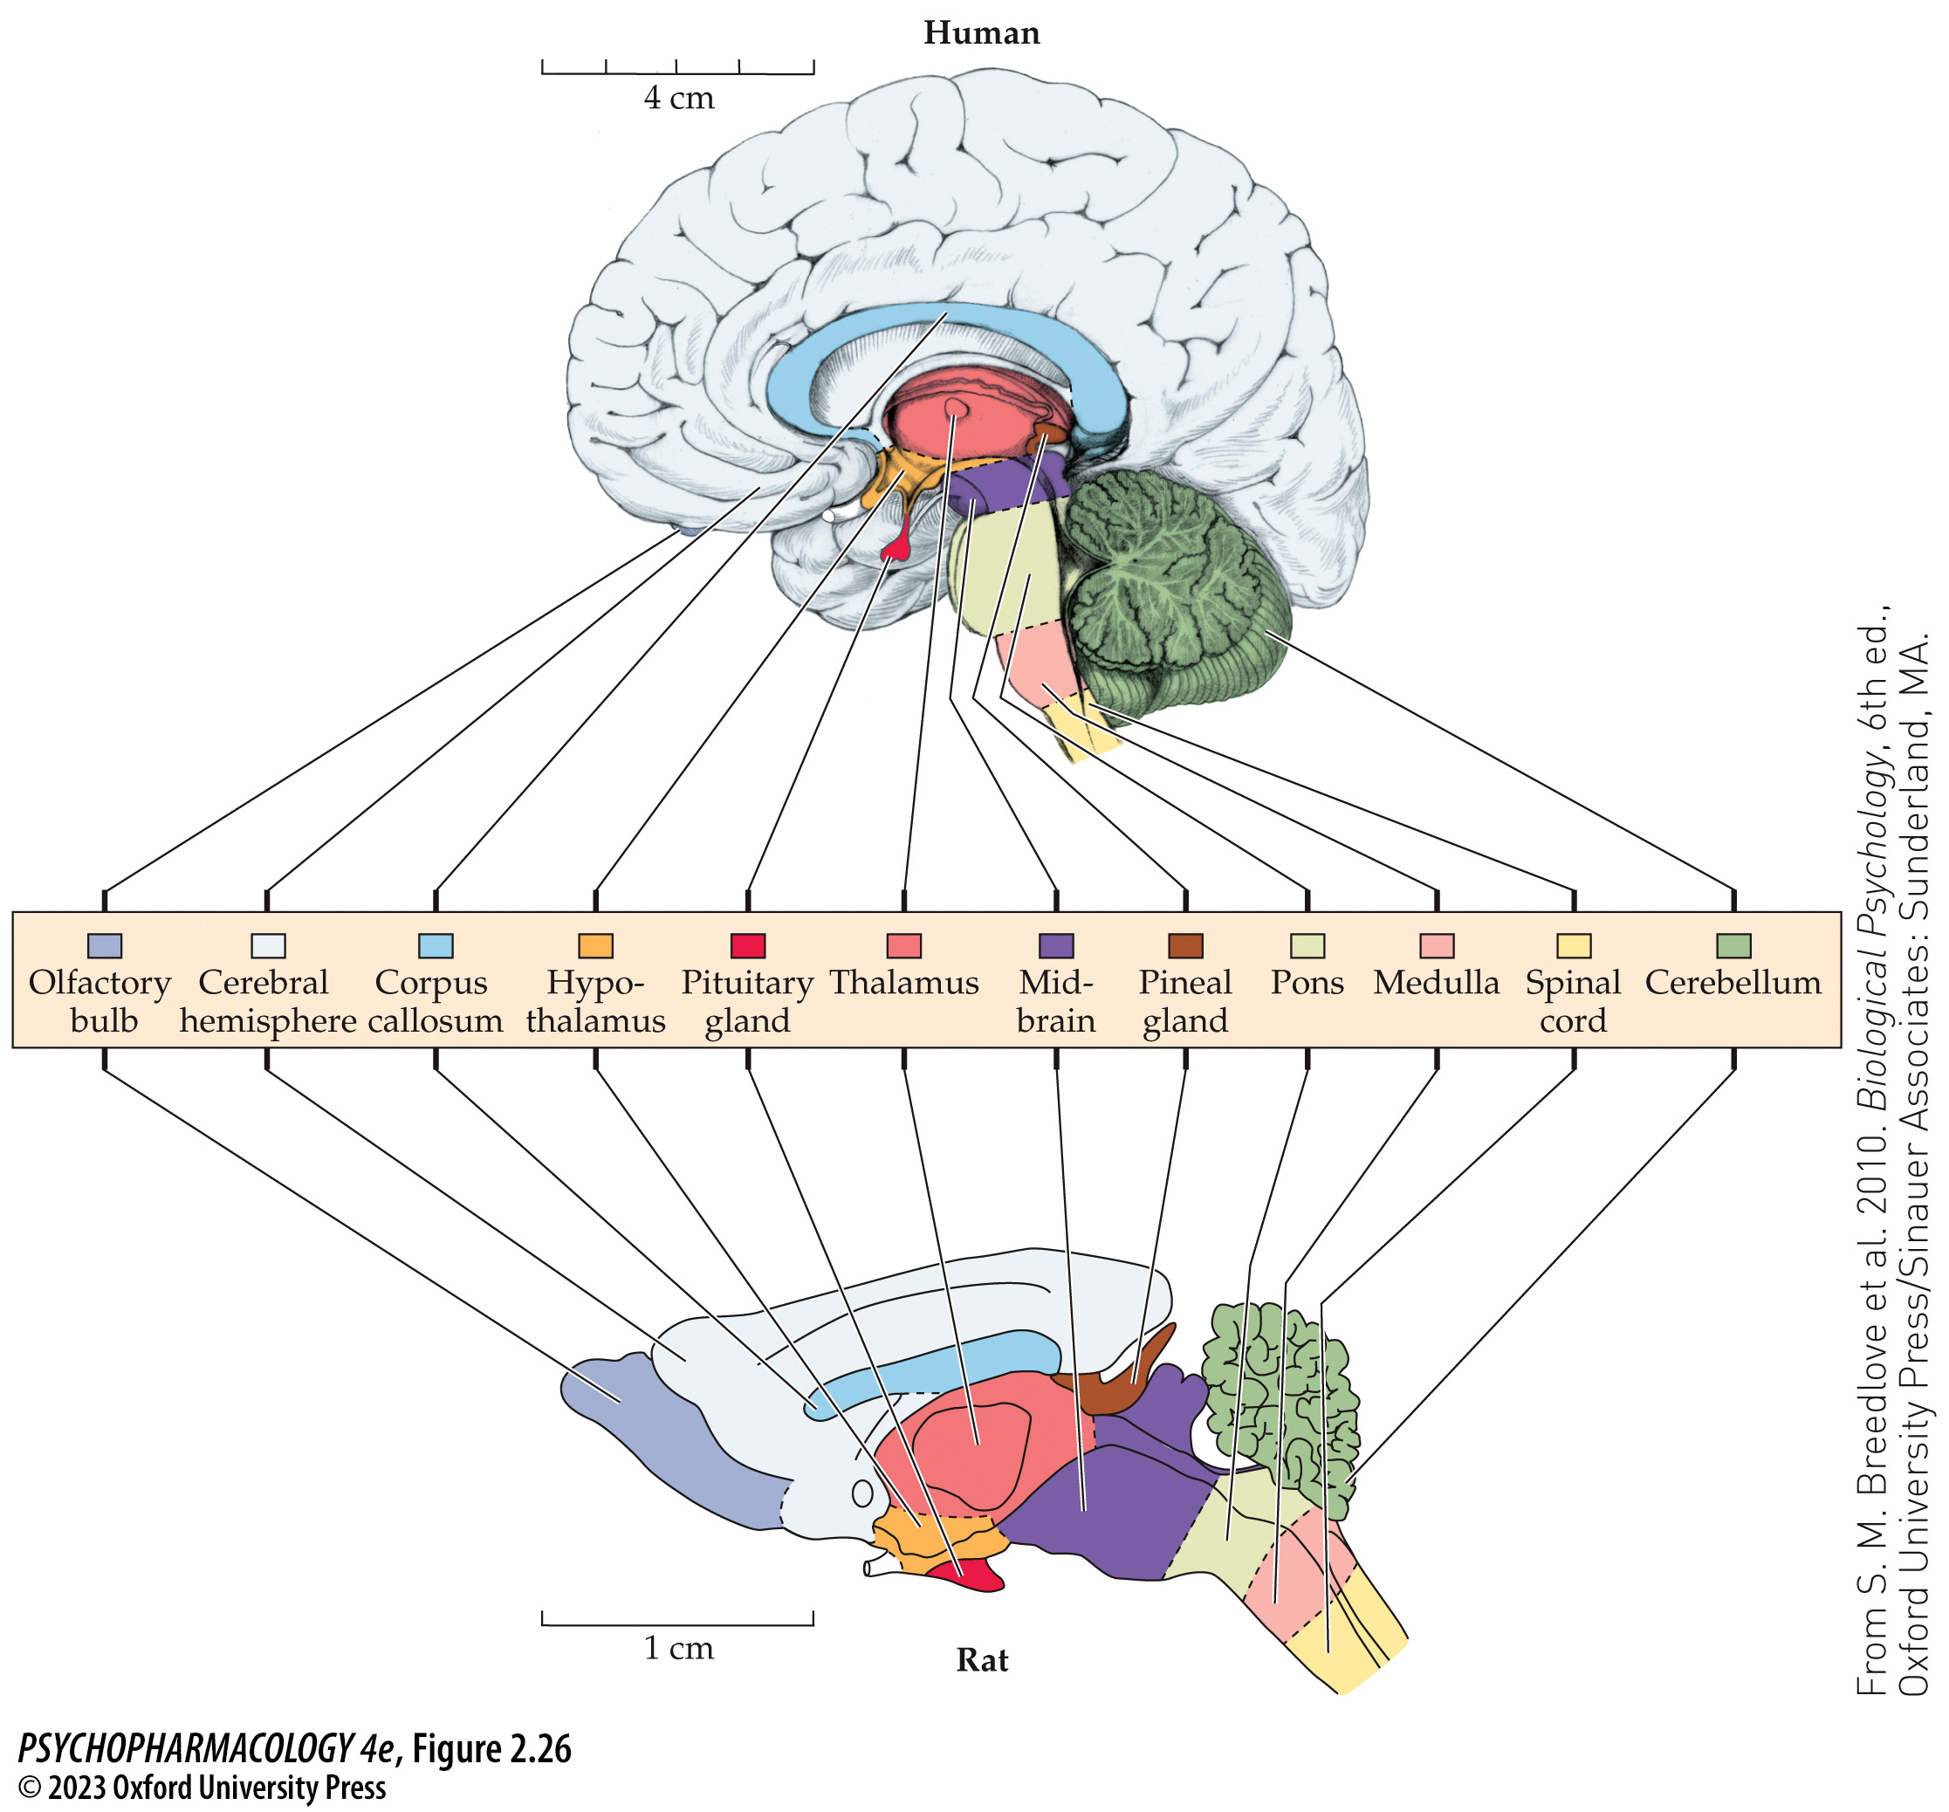
FIGURE 2.26 Comparison of human and rat brains
Notes:
FIGURE 2.26 Comparison of human and rat brains
Midsagittal views of the right hemispheres of human and rat brains show extensive similarities in brain structures and their relative topographic location. The brains differ in that the cere­bral hemispheres are relatively much larger in the human brain, while the rat has a relatively larger midbrain and olfactory bulb. The rat brain has been enlarged about six times in linear dimensions relative to the human brain. (From S. M. Breedlove et al. 2010. Biological Psychology, 6th ed., Oxford University Press/Sinauer Associates: Sunderland, MA)

Slide 60
Organization of the Nervous System (18 of 18)
CLICKER QUESTION 3
Which part of the nervous system is responsible for conserving energy and regulating body functions at rest?
Sympathetic nervous system
Parasympathetic nervous system
Limbic system
Notes:
Instructor Notes:
Correct answer: b

Slide 61
Review of Learning Objectives (3 of 3)
2.3.1 Identify and describe the major divisions of the nervous system.
2.3.2 Describe the structural features of the CNS that provide protection from injury and exchange nutrients and waste products between the brain and its blood supply.
2.3.3 Describe the cellular components that make up the gray and white matter of the spinal cord, and how these components transmit information between the brain and the periphery.
2.3.4 Describe the main biological functions of, and the primary structures within, the following anatomical subdivisions of the CNS: myelencephalon, metencephalon, mesencephalon, diencephalon, telencephalon.
2.3.5 Name the lobes of the cerebral cortex and discuss the functions associated with each.

